Slide 1
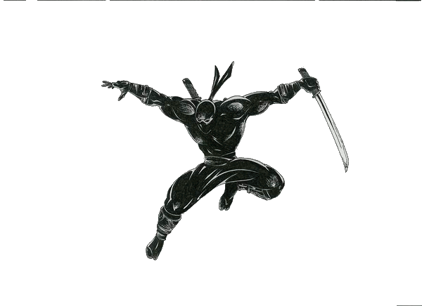
Web Application Hacking/Security 103
CIS 5930/4930
Offensive Computer Security
Spring 2014

Slide 2
Outline
SSL / TLS and the Certificate Authority infrastructure
the basics
the history, the story
the flaws
important CA attacks
lessons learned (ignored)
SSL / TLS attacks
sslstrip
sslsniff
crypto attacks
BEAST (Browser Exploit Against SSL/TLS)
CRIME

Slide 3
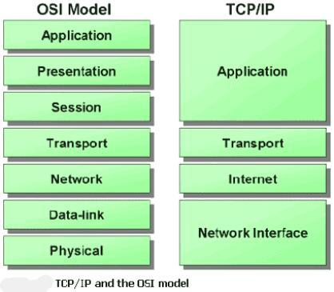
What is SSL?
Secure Sockets Layer
developed by Netscape
predecessor to TLS
a cryptographic protocol that provides secure communication over the internet
Encryption @ the application layer
asymmetric cryptography for key exchange
symmetric encryption for confidentiality
message authentication codes for message integrity

Slide 4
What is TLS?
Transport Layer Security
RFC 5246
successor to SSL
but is derived from an early version of SSL!
a cryptographic protocol that provides secure communication over the internet
Encryption @ the application layer
asymmetric cryptography for key exchange
symmetric encryption for confidentiality
message authentication codes for message integrity
(At a high level SSL and TLS are about the same)

Slide 5
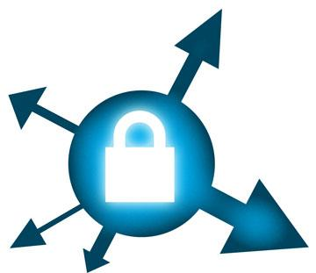
SSL / TLS uses
web browsing (HTTPS)
email
internet faxing (still exists???)
instant messaging
VOIP
etc...

Slide 6

The history
In the early 90's, at the dawn of time the World Wide Web
Engineers at Netscape developed a protocol for making secure HTTP requests
Very scarce body of knowledge about how to secure protocols
+ intense pressure to get the job done
Deadlines man!!!
4AM decisions
gave us SSL!
amazing it lasted this long
Today, the fundamental system engineered back in the 90's now faces serious problems with authenticity
Diminishing trust
Hackers are smarter
We now know more about how to secure things

Slide 7
A Secure Protocol
Secrecy
Integrity
Authenticity

Slide 8

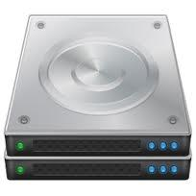
SSL / TLS Handshake
The following is sent in plaintext:
Client
Server
Client's SSL version #, Cipher Settings, Session-data, etc..
Server's SSL version #, Cipher Settings, Session-data, etc.. + Server's certificate
Client uses certificate info to authenticate the server
If authentication fails, the user is warned that an encrypted and authenticated connection cannot be established
Now encrypted communication begins...
Supported by the asymmetric key encryption
Client and server establish a master secret to generate the session key
Session key = a symmetric key used to encrypt and decrypt the session
Details depend on cipher settings
Now encrypted communication begins with the symmetric key encryption
"Begin encrypted session", Encrypted (with symmetric key) final client handshake message
"Begin encrypted session", Encrypted (with symmetric key) final server handshake message

Slide 9
so HTTPS uses Certificates
Certificate Authorities (CAs) say
"This key belongs to mail.live.com"
(Browser trusts the CAs)

Slide 10
Handshake notes
Implementation details can vary
Details can vary over versions
Client authenticates server based off of server's certificate..........
Automated to not involve the user
unless the certificate is of unknown origin....

Slide 11
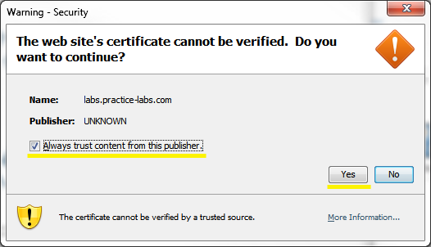
The issue of "Trust"
Trust is too hard for the normal user to think about
Browser vendors decide the trust for you!
how nice of them ^-^
Browsers ship with trusted root certificate authorities
Trusted root certificate authorities:
about 40 (chrome)
Intermediate certificate authorities
about 25 (chrome)
Users can add certificates
I don't even know 40 people that I trust!!

Slide 12
Certificates
Certificates
composed of a Public key, and a Private key
Public key certificate (aka "certificate"):
digitally signed statement that binds the value of a public key to the identity of the person, device, or service that holds the corresponding private key
usually X.509 standard certificates
designed in 1980
messy
overly flexible and general

Slide 13
Certificates
Signing (Digital Signatures)
The private key of a certificate can be used to sign a message
which is then decrypted by the public key
nonrepudiation
authenticity
Private key can be used to sign other user's public keys
establish a trust relationship
Verisign signs the certificate for Microsoft
(Verisign trusts Microsoft)
foundation to the public key infrastructure (PKI)

Slide 14
Public Key Infrastructure
A public-key infrastructure (PKI)
set of hardware, software, people, policies, and procedures needed for digital certificate:
creation,
management,
distribution,
use,
storage,
and revokation
certificate black-lists exist.
and they work!

Slide 15
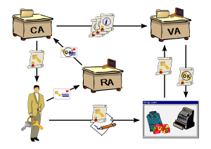
Public Key Infrastructure
Certificate Authorities (CA)
binds the public keys with the respective user identities
user identities MUST be unique
CA uses it's own private key to sign user's public key
Validation Authority (VA)
3rd party exists to provide and vouch for user information
involved in registration and issuance process
Registration Authority (RA)
Exists to ensure that the public key is bound to the individual to which it is assigned
to ensure non-repudiation

Slide 16

CA chains
Certificates have permissions / capabilities
ROOT CA's can sign the key of other CA's
ROOT CA
Intermediate CA
?
Should NOT happen
But is an option if you have enough $$$$
(still is rare)

Slide 17
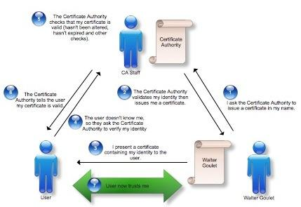
Getting a certificate for your website
img source: http://blog.securism.com/2009/01/summarizing-pki-certificate-validation/

Slide 18
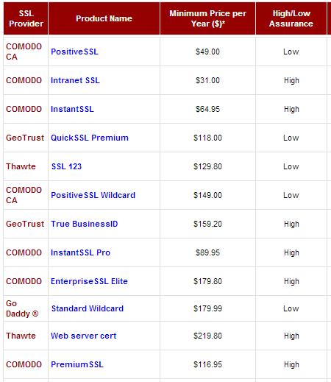
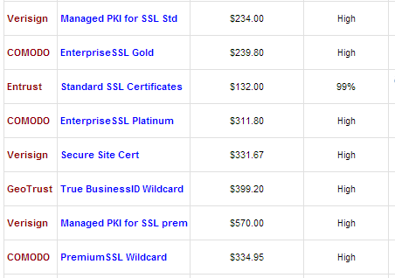
Getting a certificate for your website
Getting a cert means:
forking over $
provide identifying info about yourself
promising to play nice
you are buying their trust

Slide 19
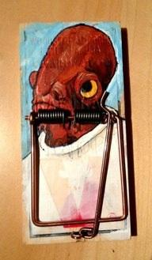
Getting a certificate for your website
But how do website owners decide?
They all do the same thing right?
why not buy the cheapest
After all, they're all "trustworthy"!

Slide 20
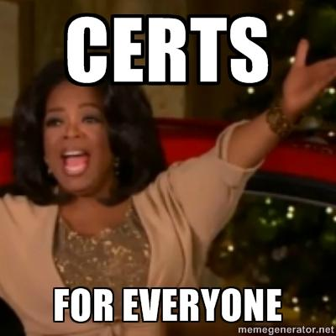
Who can become a CA?
You
Me
Anyone really..
But you have to get someone to trust you

Slide 21
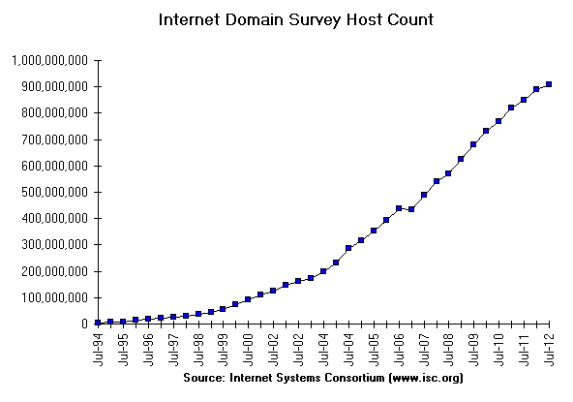
Securing the Internet

Slide 22
CA chains
The 40 root CA's your browser trusts
leads to an exponentially large network of CA's that you trust
ROOT CA
Intermediate CA

Slide 23

IN PRACTICE
Certificate Authorities (CA)
Are the single point of failure
top target for hackers
Look bad if they get hacked
meh, brush it under the rug!
Validation Authority (VA)
who?
usually don't even exist
involved in registration and issuance process
issuance-smishuance
registration-smegistration
Registration Authority (RA)
Probably an intern at the CA
supposed to be a 3rd party
keeps an "eye out" for "bad things"
DOING EVERYTHING RIGHT COSTS $$$
Competing with the lowest bidder
pricing is all artificial anyways
ZERO consequences when EVERYTHING goes wrong

Slide 24
CA blues
1980s
x.509 designed
(pro and con) flexible and general
ugly as hell
long history of implementation vulnerabilities
1990's
SSL conceived
2009
Three major vulnerabilities affected the world, just due to CA mistakes
whoops I published my private key in my public_html directory
2010
growing evidence of governments compelling CAs to do their bidding
https://www.eff.org/files/ccc2010.pdf
https://www.eff.org/observatory

Slide 25
Intermission
Let us peruse the SSL observatory
https://www.eff.org/files/colour_map_of_CAs.pdf A map of the organizations that can function as CAs that are trusted (directly or indirectly) by Mozilla or Microsoft (total of 650 CAs in that list)

Slide 26
Noteworthy CAs on that list
U.S. Department of Homeland Security
U.S. Defence Contractors
CNNIC, 2007
(China Internet Network Information Center)
Etisalat
(Emeriates Telecommunications Corporation)
The Island of Berumuda
Are trusted as CAs by either Microsoft or Mozilla
Transitively your browser trusts them by default too

Slide 27
Scoping Issues
Maybe DHS should just sign for sites in the USA
and likewise Chinese state run CA's should just sign for sites in China
DHS
CHINA
But naturally there are americans who would never trust DHS as a CA
and chinese citizens who would never trust any chinese CAs

Slide 28
Securing the Internet

Slide 29
Important CA "attacks"
The following people were just able to obtain a major certificate without hacking
Mike Zussman obtained login.live.com
simply just asked for it
to do his security research
Eddy Nigg obtained mozilla.com
no Validation Authority (VA) stopped him
he was investigating unethical CA practices
didn't have to try very hard to hit a jackpot
http://www.sslshopper.com/article-ssl-certificate-for-mozilla.com-issued-without-validation.html
Verisign issued a code signing cert for "Microsoft Coporation" to unknown hackers
could sign KMDs, Windows Updates, Applications, etc..

Slide 30
APT
"cyber"

Slide 31
Important CA attacks
RSA (2010)
SecureID program compromised
Not really SSL, but similar in concept
Massive hack hit 760 companies
google
facebook
microsoft
20% of the Fortune 100 list
many more in the Fortune 500
http://money.cnn.com/2011/10/27/technology/rsa_hack_widespread/index.htm

Slide 32
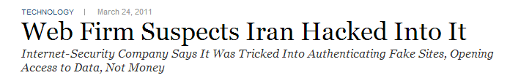
Important CA attacks
Comodo
hacked in March 2011
Attacker IP address: 212.95.136.18
GPS Longitude & latitude: 35.696111 51.423056
attacker made off with some important certs
mail.google.com
www.google.com
login.yahoo.com
login.skype.com
addons.mozilla.org
login.live.com
...

Slide 33
Important CA attacks
Comodo (continued)
Immediately after the attack, the CEO issued the following statement:
“This [attack] was extremely sophisticated and critically executed… it was a very well orchestrated, very clinical attack, and the attacker knew exactly what they needed to do and how fast they had to operate”
Also claimed that all of the IP addrs involved in the attack were from Iran.
sparked debate on "cyber war"
"All of the above leads us to one conclusion only: that this was likely to be a state-driven attack."
drama ++
quotes cited from: http://privacy-pc.com/articles/ssl-and-the-future-of-authenticity-comodo-hack-and-secure-protocol-components.html

Slide 34
Important CA attacks
Comodo (continued)
It turned out that the hacker was an amateur
script kiddie who talks a really BIG game
its hilarious
see his/her ramblings: http://pastebin.com/85WV10EL
Comodo secures 25% - 20% of all sites on the internet
Surely there must be consequences! A amateur breaking 25% of the internet is preposterous!
Got hacked 3 times later that year
And no one cared
Nothing happened to Comodo!
Comodo CEO named entrepreneur of the year at RSA 2011

Slide 35
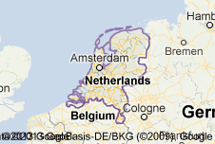
Important CA attacks
DigiNotar (2011)
DigiNotar issued a rouge *.google.com certificate
presented a number of Internet users in Iran
noticed by DigiNotar, and then quickly revoked
Hackers!
Important because the ENTIRE DUTCH GOVERNMENT runs off of DigiNotar certificates
Thus the hackers were able the hack the ENTIRE DUTCH GOVERNMENT (in a sense)
http://www.f-secure.com/weblog/archives/00002228.html
Hacker's "proof" http://pastebin.com/jhz20PqJ
DigiNotar got dropped by most browser vendors

Slide 36
Important CA attacks
DigiNotar (continued)
Dutch government took over the company afterwards
That same month, the company was declared bankrupt
http://en.wikipedia.org/wiki/DigiNotar
Lesson learned: you are not too big to fail, if you cause someone bigger than you to fail, when you fail
Total Compromise of CA servers:
http://threatpost.com/en_us/blogs/final-report-diginotar-hack-shows-total-compromise-ca-servers-103112
StartCom (2011)
Israeli CA
simply just rumors of a breach
GlobalSign (2011)
possibly compromised by same hacker that got DigiNotar
reports concluded there was no evidence of any breach
It is important to note how rumors of breaches affect "trust"

Slide 37
Important CA attacks
Verisign repeatedly hacked (2010-2011)
revealed hacks in a quarterly SEC (Securities and Exchange Commission) filing in October 2011
only because new SEC guidelines required reporting security breaches to investors
these new guidelines have resulted in an EXPLOSION of reports/filings disclosing security breaches and breach risks http://blogs.reuters.com/financial-regulatory-forum/2012/04/06/disclosures-2012-level-of-cyber-security-risk-disclosures-varies-after-new-sec-guidance/
secures over 50% of the internet
.com .net .gov
allows hackers to impersonate any company on the net
not sure as to the extent of the hack
Verisign's DNS system processes 50+ billion queries per day
report implies APT / nation-state attack
SSL hit? we don't know...
Verisign sold its SSL business to Symantec, summer 2010

Slide 38
A Secure Protocol......
Secrecy
everyone's a CA now a days
Integrity
no accountability for CAs
Authenticity
CAs can give your cert away to others by accident

Slide 39
"the security of HTTPS is only as strong as the practices of the least trustworthy/competent CA,"
EFF SSL Observatory
https://www.eff.org/observatory

Slide 40
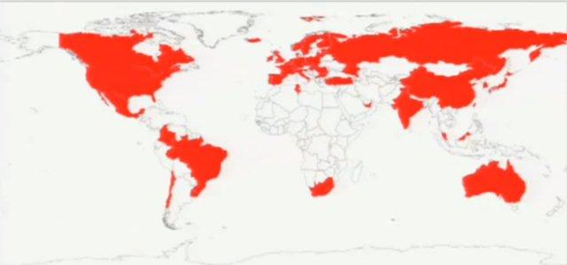
Countries than can intercept secure communications (SSL)
[source eff ssl observatory]

Slide 41
The flaw
We are locked into these trust relationships
Market forces reward the cheapest "Trust" vendors
only natural to see so many hacks
imagine the ones that don't get detected / reported
The browser vendors could have dropped Comodo after their ridiculous hacks
Would have broken 25% of the internet
Convenience won out, and we still trust Comodo to this day
There is no "agility" in the current model
we cannot adapt to disturbances in trust
trust becomes forever

Slide 42
Defending against the Broken CA system
skim: http://csrc.nist.gov/publications/nistbul/july-2012_itl-bulletin.pdf
in summary:
...Its complicated...

Slide 43
Alternatives to the broken CA system
http://convergence.io/
Moxie Marlinspike
Trust Agility
Firefox plugin
its simple and it works

Slide 44

Attacking SSL
(without targeting the CA system)

Slide 45
SSL / TLS Handshake
The following is sent in plaintext:
Client
Server
Client's SSL version #, Cipher Settings, Session-data, etc..
Server's SSL version #, Cipher Settings, Session-data, etc.. + Server's certificate
Client uses certificate info to authenticate the server
If authentication fails, the user is warned that an encrypted and authenticated connection cannot be established
Now encrypted communication begins...
Supported by the asymmetric key encryption
Client and server establish a master secret to generate the session key
Session key = a symmetric key used to encrypt and decrypt the session
Details depend on cipher settings
Now encrypted communication begins with the symmetric key encryption
"Begin encrypted session", Encrypted (with symmetric key) final client handshake message
"Begin encrypted session", Encrypted (with symmetric key) final server handshake message

Slide 46
Tools for breaking SSL/TSL
sslstrip
uses ARP poisoning to MITM attack unwitting users
sslsniff
provided a CA cert, can decrypt all SSL/TLS traffic
BEAST
Juliano Rizzo and Thai Duong (2011)
attacks TLS 1.0, 1.1
CRIME
Juliano Rizzo and Thai Duong (again 2012)
attacks all versions of TLS/SSL
details unknown
Or the slew of SSL bugs that have recently come out
Linux GNUUtils
iOS “goto fail” bug
and the many others over history.

Slide 47
sslstrip
need to be on same network as your victim
ARP spoof the victim
impersonate the gateway
all traffic routes through you then
Once you intercept all traffic:
replace all GET HTTPS / POST HTTPS with
GET HTTP
POST HTTP
simply just replace HTTPS with HTTP

Slide 48
SSLSTRIP tutorial
View: http://www.youtube.com/watch?v=Q1hnHbBb_bA

Slide 49
defeating sslstrip
Have your website run strict transport security
ssl on all pages
MANY websites do not do this
due to incompentence
there is NO other excuse now a days
A HTTP request to your server will always respond with a HTTPS response.
no more downgrading from HTTPS to HTTP
plain HTTP not permitted

Slide 50
sslsniff
requires being able to monitor the communication of your intended victim
requires also having the certificates to decrypt the SSL/TLS traffic
Bad guys do this after hacking a CA
cannot be defended against

Slide 51
BEAST
Crypto attack tools
can strip HTTPS cookies from a session
< 10 minutes
exploits vulnerabilities in TLS 1.0, 1.1
Defense is to use latest TLS / SSL versions

Slide 52
Illustrated Guide to BEAST
http://commandlinefanatic.com/cgi-bin/showarticle.cgi?article=art027

Slide 53
CRIME
Similar to BEAST
details not fully disclosed yet
supposedly affects all versions of TLS / SSL

Slide 54
Required Reading:
“SSL and the future of Authenticity”: https://www.youtube.com/watch?v=Z7Wl2FW2TcA
Certified Lies: Detecting and Defeating Government
Interception Attacks Against SSL
http://files.cloudprivacy.net/ssl-mitm.pdf
Read Chapter 10 in WAHH

Slide 55
The end
questions?

